Slide 1
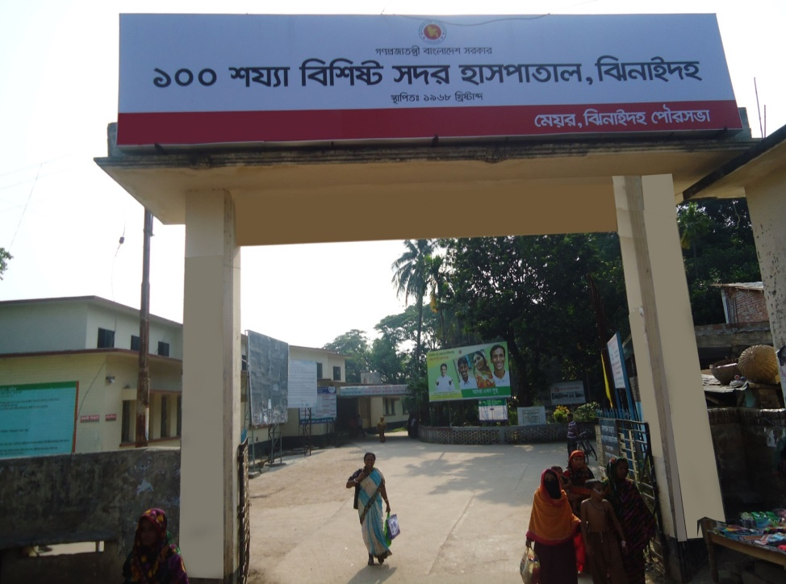
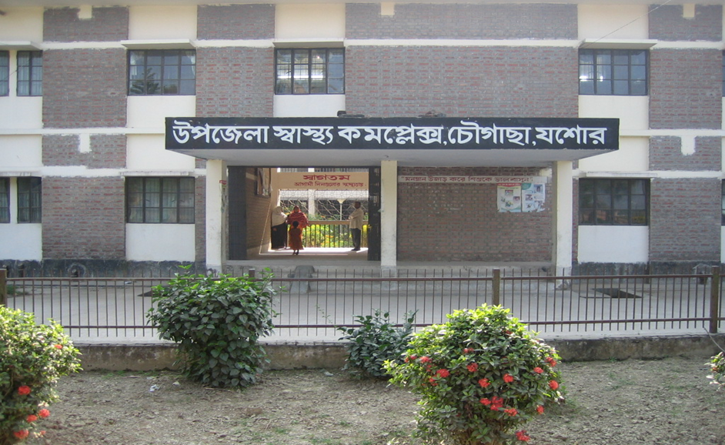
Chowgacha Jhenaidah Model, Achievements and Improvements
Dr. Md.Emdadul Haque
Senior Consultant
DGHS

Slide 2
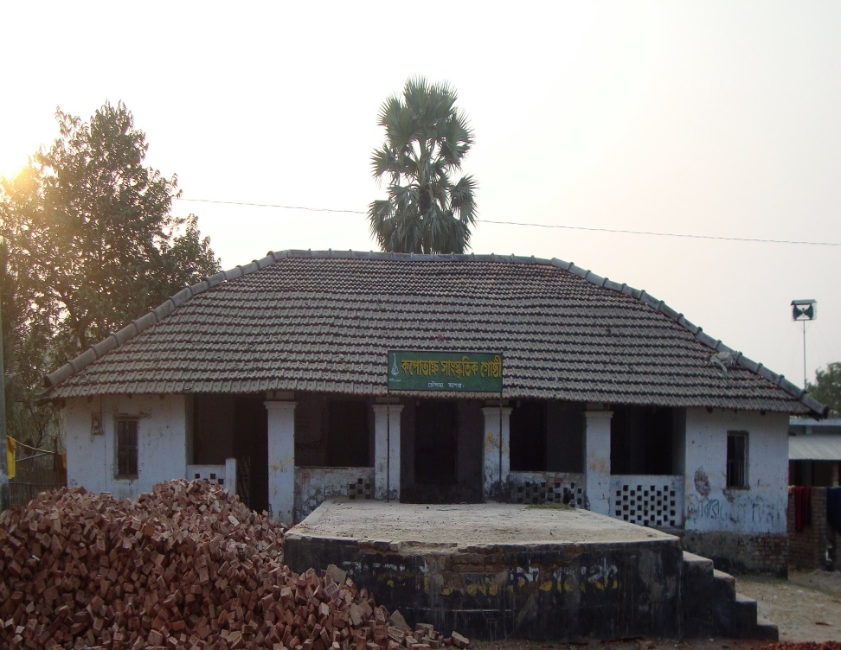

50 BEDED UPAZILA HEALTH COMPLEX
Chowgacha, Jessore.

Slide 3
MDG 4 and 5 Achieved in
Jhenaidah in 2009
Per 1000 live Birth Jhenaidah MDG Target National
MMR: .60 1.47 1.94
(MDG 5 Achieved)
IMR: 32 31 38
(MDG 4 near to target)
<5 MR: 42 50 46
(MDG 4 Achieved)

Slide 4
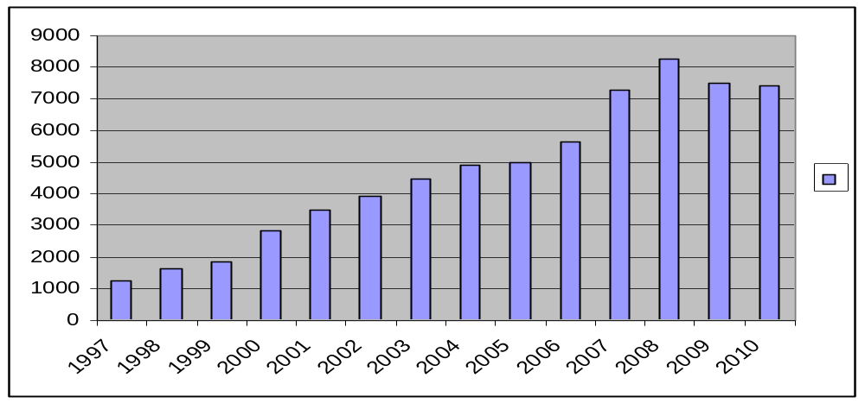
Upazila Health Complex
CHOWGACHA , JESSORE.
EOC Activities : 1997- 2010 (ANC First Visit)
8263
7292
7499
7427
5644
4898
4993
4484
3932
3509
2861
1631
1851
1228

Slide 5
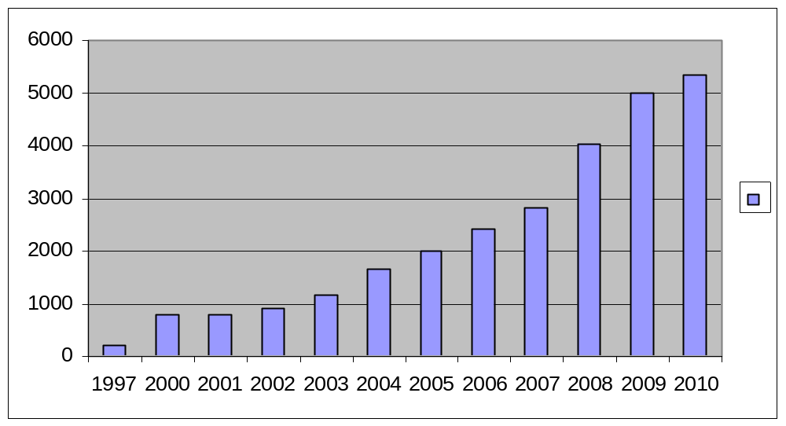
Upazila Health Complex
CHOWGACHA , JESSORE.
EOC Activities : 1997- 2010 (Admission in labour ward
5329
4978
4031
2807
2397
2013
1649
1145
773
769
910
214

Slide 6
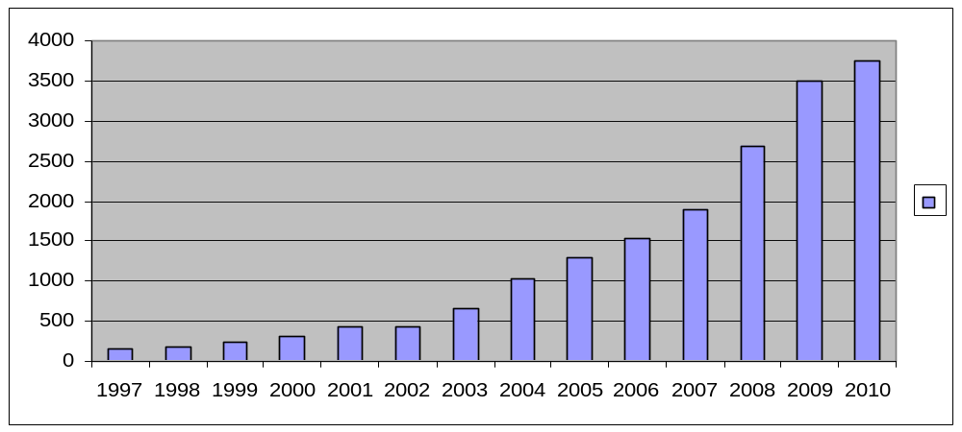
Upazila Health Complex
CHOWGACHA , JESSORE.
EOC Activities : 1997- 2010 (Hospital Delivery )
3755
3489
2682
1899
1518
1293
1030
661
312
421
422
151
182
228

Slide 7
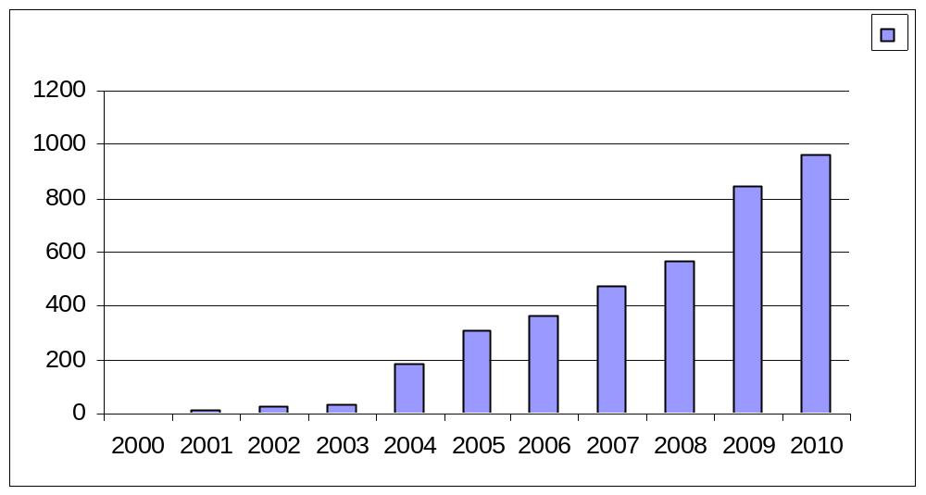
Upazila Health Complex
CHOWGACHA , JESSORE.
EOC Activities : 2000 - 2010 (Caesarian Section)
962
842
567
473
363
310
184
3
11
26
36

Slide 8
Upazila Health Complex
CHOWGACHA , JESSORE.
Progress Of EOC Activities based on UN Process Indicators
SL No | Indicators | 2005 | 2006 | 2007 | 2008 | 2009 | 2010 | Target of UN Process
01 | Total Pregnancy | 5270 | 5365 | 5489 | 5793 | 5595 | 5208 | -
02 | Total Hospital delivery | 1293 | 1518 | 1899 | 2682 | 3489 | 3755 | -
03 | Total Caesarian section | 310 | 363 | 473 | 567 | 842 | 962 | -
04 | Maternal death in health Complex. | 03 | 01 | 01 | 3 | 0 | 0 | -
05 | % of birth in health Complex. | 26.5% | 32.3% | 38.1% | 52.4% | 72% | 84.8 | >15%
06 | Met-need for EmOC | 92.1% | 113% | 107% | 175 % | 232% | 267% | 100%
07 | Caesarian section of all births | 6.3% | 7.4% | 9.7% | 11% | 17.3%* | 21.7 | 5-15%
08 | Case Fatality Rate | 0.44% | 0.12% | .13% | 0.20% | 0.0% | .0% | <01%
* NB: Among the total delivery of Chowgacha Upazilla, the CS rate is 14% but CS 7.7 % is
increased due to complicated delivery from outside this upazilla.

Slide 9
Upazila Health Complex
CHOWGACHA , JESSORE.
Comparative Data of Delivery of best performing EOC center of Khulna Division in 2009
SL No | Name of institute | NVD | Vacuum Del. | V. Breech | C. Section | Total
01. | Chowgacha UHC | 2552 | 58 | 37 | 842 | 3489
02. | Ad-din Hospital Jessore. | 1113 | 0 | 0 | 1645 | 2758
03. | KMCH Khulna | 1387 | 56 | 5 | 928 | 2376
04. | 250 bed Hospital, Khustia | 1435 | 0 | 26 | 881 | 2342
05. | 250 bed Hospital, Jessore | 871 | 0 | 0 | 1278 | 2149
06. | Fatima Hospital Jessore. | 586 | 0 | 7 | 1096 | 1689

Slide 10
Upazila Health Complex
CHOWGACHA , JESSORE.
EOC ACTVITIES : ( Vision By The Year 2010)
SL No | Indicator | Achived |  |  |  |  |  | Target
 |  | 1997 | 2000 | 2005 | 2008 | 2009 | 2010 | 2010
01 | ANC 1st Visit % | 24.6 | 59 | 94.7 | 143.0 | 147 | 142.6 | 100
02 | ANC 2nd Visit % | 11.6 | 33.4 | 68 | 108 | 119 | 118.2 | 100
03 | ANC 3rd Visit % | 9.2 | 22 | 39 | 59.6 | 109 | 87.6 | 100
04 | PNC % | - | 5.5 | 13.5 | 39.3 | 64 | 59.1 | 80
60 | Hospital Delivery Rate% | 3.4 | 6.4 | 26.5 | 52.4 | 72 | 84.4 | 90
06 | Caesarian Section Rate% | 0 | 0.07 | 6.3 | 11.0 | 17.3 | 21.7 | 15
07 | Maternal Mortality Ratio / 100000 Live birth | 210 | 168 | 160 | 120 | 42 | 42 | 42
08 | Neonatal Death Rate / 1000 live birth | 42.4 | - | 21.5 | 16.5 | 19.3 | 16.7 | 15

Slide 11
Factors Responsible for Reduction of Maternal and Infant Mortality Rate in Chowgacha
Special Activities initiated by Medical Officers in February 1996:
Setting up ANC Corner – Headed by female Medical Officer for pregnant mother for effective ANC services who receive TT immunization in the Health Complex;
Initiation of Basic EOC Service by a Gyne & Obs. trained Medical officer;
Establishment of Under 5 Corner for under 5 children for their nutritional assessment and treatment by Resident Medical Officer;
Record Keeping of Monthly Birth and Death by specially developed format by health assistant throughout the Upazilla supervised by UH&FPO;
Wide and Continuing Dissemination of Health Promotion ad Education Messages among women coming for antenatal care, pregnant women and general patients and their attendants at all corners;
One Package Service Corner from where we provide ANC registrations, EPI fixed centre, ORT service, audio-visual health educations and health nutritional education;

Slide 12
Factors Responsible for Reduction of Maternal and Infant Mortality Rate in Chowgacha- Contd.
Maintaining all criteria for woman friendly hospital like separate female pts. registration, separate ANC service by female doctor;
Rest Room for Pregnant Women where health education is given daily by nursing supervisor & audiovisual system;
Operating Blood Bank System by registered about 600 donors addresses within 1 km. radius of the hospital; Community supports like ANC card, blood grouping reagents, etc.;
Mobile phone in emergency, indoor, EOC to provide telephonic health service facility and emergency ambulance service;
Well equipped Emergency Department supported with spot light, sterilizer, emergency drugs and Oxygen & others;

Slide 13
Upazila Health Complex
CHOWGACHA , JESSORE.
Community Support
Protocol board donated b y Deputy Commissioner Jessore.
Blood Group reagents and blood bags donated by Chairman Chowgacha up at first in
1996 & recently blood bags donated by 11 UP chairman .
ANC& growth monitoring card donated by Ad-Din hospital , JICA , Upazilla Parishad and
ACI Pharmaceutical.
One IPS & 2 cleaners donated by Chairman Municipalities.
Salary of Aya, ward boy, Cleaners Security guard and other supporting stuffs (36 in no.)
are donated by the community.
Mobile phone, Dustbin and salary of 7 manpower donated by Mr. Hasnuzzaman Rahin,
Industrialist and recently he give the support of about one lack TK. for making a reception centre, tiles around the pillars of outdoor and beautification of road.
Drugs for Arsenicosis donated by Upazila Parishad.
Salary of 01 cleaner donated by Mr. Abdur Kader pintu, Industrialist.
Supply of Matir Bank by Some NGOs.
1st Annual Report 1997 printed and all time Computer’s support by Grameen Unnayan
Sangstha ( GUS) NGO, Chowgacha.
2 Tyars of Ambulance donated by 11 UP chairman.
Blood donated by about 732 enlisted blood donors in emergency need (Transfusion of 165
bag F/blood are given in 2009)
Fuel of Generator donated by Upazilla Parishad and UNICEF through WF.
Various types of donations by the doctor's of the hospital.
Out door and indoor tickets donated by Pharmaceuticals.

Slide 14

Thank you

